Slide 1
Surrogate Modeling Using SU2
Pointwise® and SU2 Joint Workshop
Sept 29-30, 2014
Trent Lukaczyk
Aeronautics & Astronautics Department (Stanford University)

Slide 2
Problem Setup
Design of Experiments
Data Processing
Optimization

Slide 3
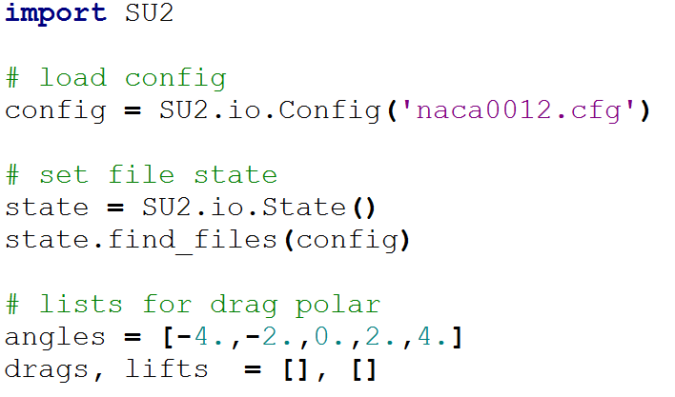
A Simple Script
This script runs a simple drag polar

Slide 4
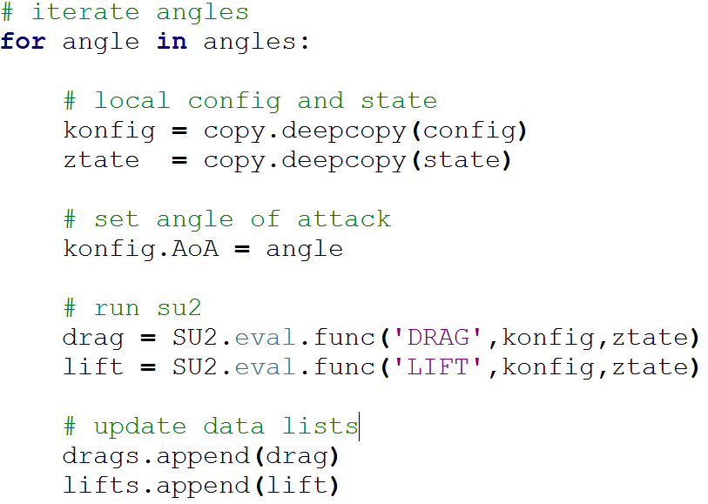
A Simple Script
This script runs a simple drag polar

Slide 5
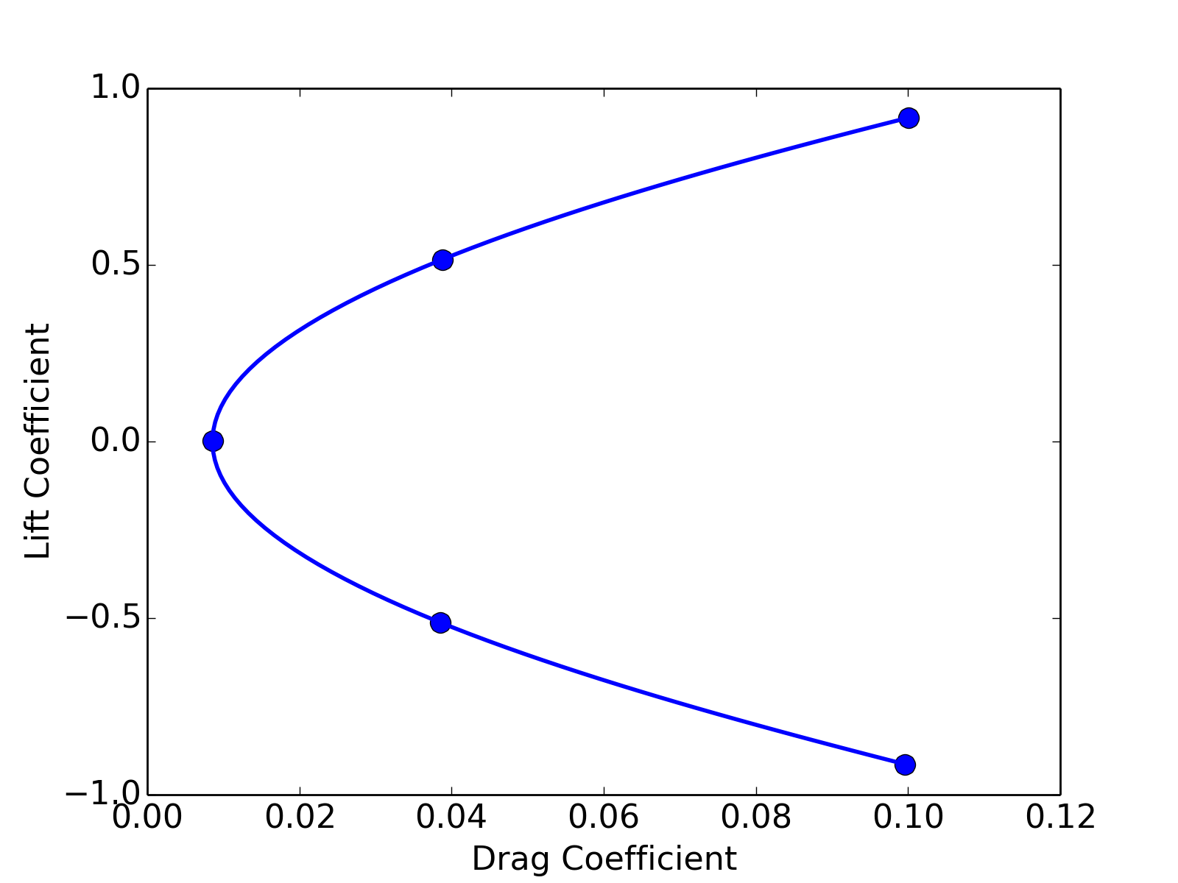
A Simple Script
The resulting drag polar plot

Slide 6
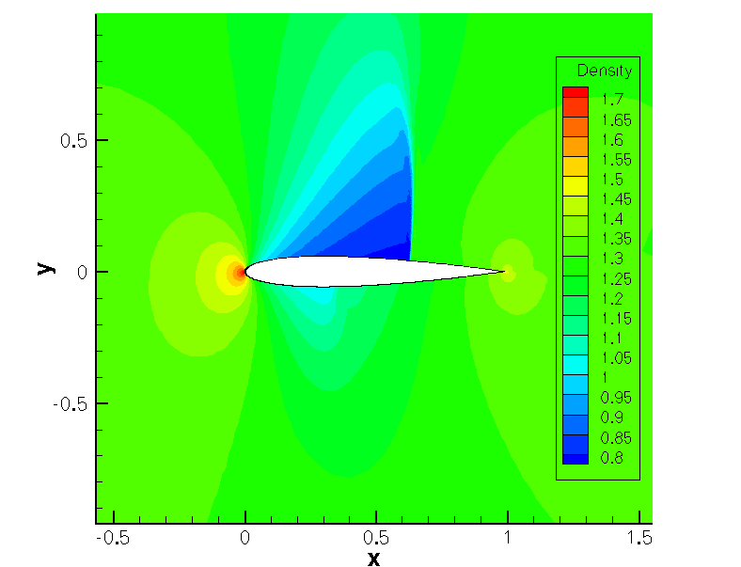
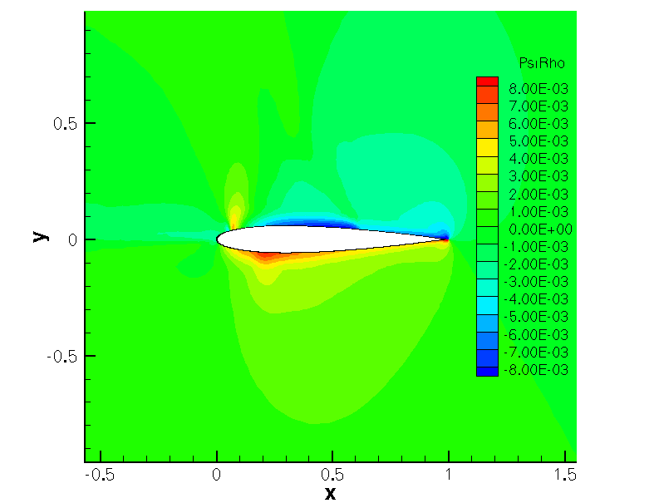
NACA 0012 Optimization Problem
Ma=0.8, AoA=1.25⁰
Euler second order
Surface based continuous adjoint formulation
Hicks-Henne bump function design variables
Contours of Density
Contours of Drag Adjoint Density
Notes:
Justify naca 0012
How gradient is calculated (integral of function of gradient of adjoint over surface - problems)
Volume formulation – expensive (perturbation of the mesh)
The problem…
The significance of the results will stand on the fact that this is a standard test case, and if we encounter difficulties here we can expect at least as much difficulty in more realistic 3D test cases.
Shown on the slides are contours of density from direct, and adjoint density from cadj solutions
The flow fields are notably different, which has implications in how we adapt

Slide 7
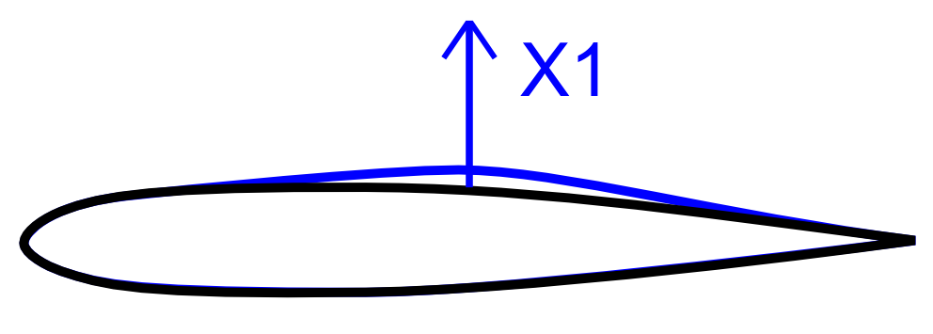
Problem Setup
Minimize drag while maintaining a minimum lift
Vary the airfoil’s shape with one Hicks Henne Bump Function
Min.
s.t.
C_{D}(X1)
C_{L}(X1) > 0.3200

Slide 8
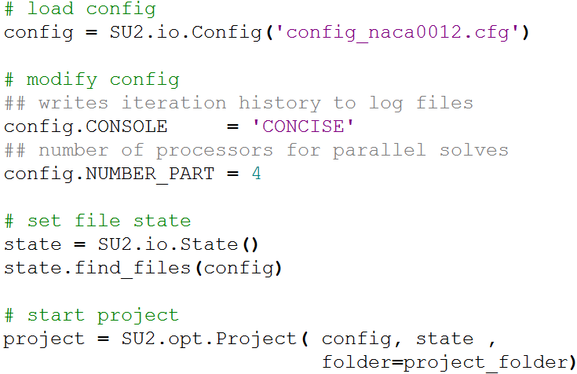
SU2 Project Setup
SU2 has a python object that can manage design evaluations – SU2.opt.Project(). Here’s how to set it up.

Slide 9

Saving and Loading Projects
Projects save themselves with each call to a major component, like deformations, direct solutions, or adjoint solutions.
Loading them can save you the time of re-evaluating solutions.
To start over, delete the project.pkl file, or move it to an archive directory.

Slide 10
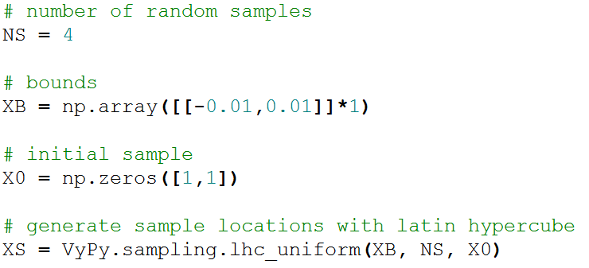
Design of Experiments
To generate a surrogate model, we need to take a random sampling of the design space. This sampling we choose by a design of experiments. In this case we’ll use Latin Hypercube Sampling.

Slide 11
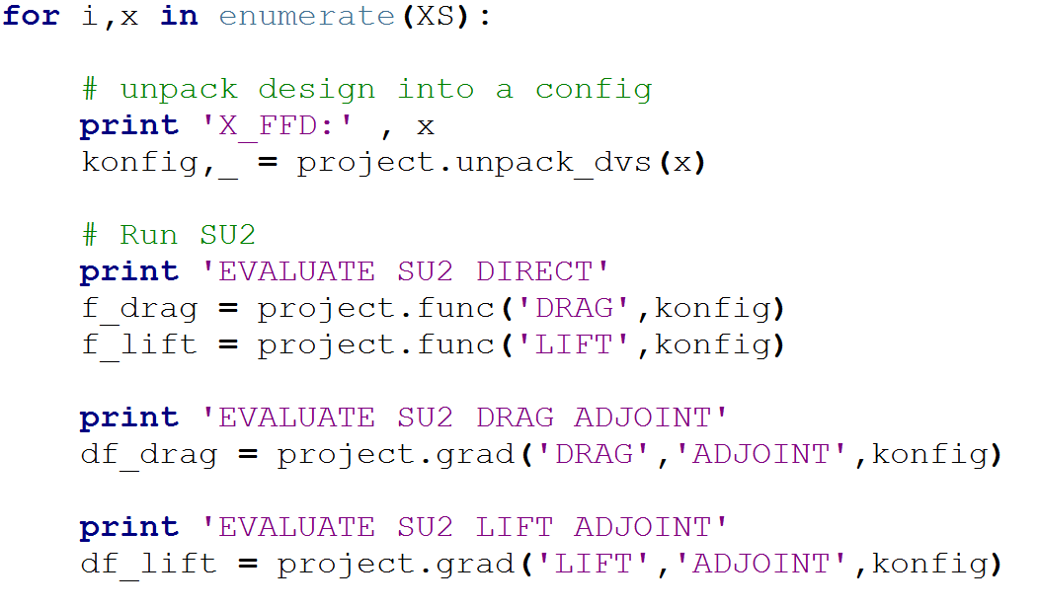
Running the Experiments
This loop evaluates SU2 at each design sample.

Slide 12
Checking the Logs
While SU2 is Running, you can check the log files to make sure it’s doing what you expected.
trent@ubuntu:NACA_Case$ cd projects/Test_Project/
trent@ubuntu:Test_Project$ cd DESIGNS/DSN_001/
trent@ubuntu:DSN_001$ cd DIRECT/
trent@ubuntu:DIRECT$ tail log_Direct.out
Iter Time(s) Res[Rho] Res[RhoE] Clift Cdrag
20 0.085426 -1.331934 4.097121 0.331850 0.018830
21 0.085269 -1.364276 4.062276 0.329838 0.019734
22 0.085333 -1.399437 4.026648 0.327799 0.020649
23 0.085257 -1.434665 3.991820 0.326023 0.021490
24 0.085094 -1.467139 3.958620 0.324635 0.022197
25 0.084995 -1.497680 3.924778 0.323653 0.022728
trent@ubuntu:DIRECT$

Slide 13
Data Exploration
You can also interact with the project through the python interpreter.
trent@ubuntu:NACA_Case$ cd projects/Test_Project/
trent@ubuntu:Test_Project$
trent@ubuntu:Test_Project$ python
Python 2.7.7 |Anaconda 2.0.1 (64-bit)
>>> import SU2
>>>
>>> project = SU2.io.load_data('project.pkl')
>>>
>>> project.results.keys()
['FUNCTIONS', 'GRADIENTS', 'VARIABLES', 'HISTORY']
>>>
>>> project.results.FUNCTIONS.keys()
['LIFT', 'DRAG', 'SIDEFORCE', 'MOMENT_X', 'MOMENT_Y', 'MOMENT_Z', 'FORCE_X', 'FORCE_Y', 'FORCE_Z', 'EFFICIENCY']

Slide 14
Data Exploration
>>> print project.results.FUNCTIONS.LIFT
[0.3269416468, 0.2703001641, 0.3528436174, 0.3799183762, 0.3040688057, 0.3269073365, 0.3203853104]
>>> print project.results.VARIABLES
[[0.0], [0.0089448155956601046], [-0.0042716224182653443], [-0.0089275210543810577], [0.0036615329193177178], [6.0326879239180899e-06], [0.0011200741319185093]]
>>>
>>> project.results.HISTORY.DIRECT.keys()
['ITERATION', 'LIFT', 'DRAG', 'SIDEFORCE', 'MOMENT_X', 'MOMENT_Y', 'MOMENT_Z', 'FORCE_X', 'FORCE_Y', 'FORCE_Z', 'EFFICIENCY', 'Res_Flow[0]', 'Res_Flow[1]', 'Res_Flow[2]', 'Res_Flow[3]', 'Res_Flow[4]', 'Linear_Solver_Iterations', 'TIME']

Slide 15
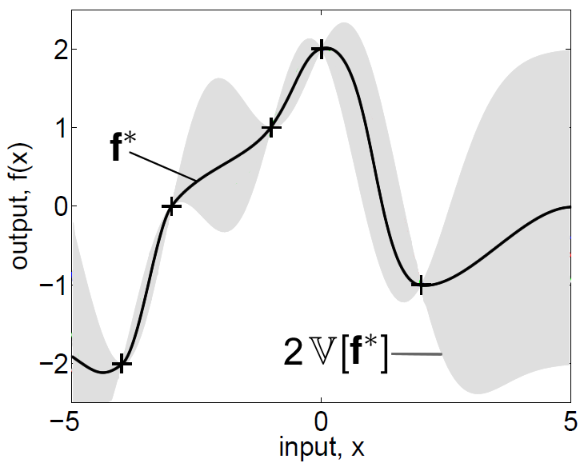
Surrogate Modeling
With this data we’ll build a surrogate model.
Rasmussen, 2006

Slide 16
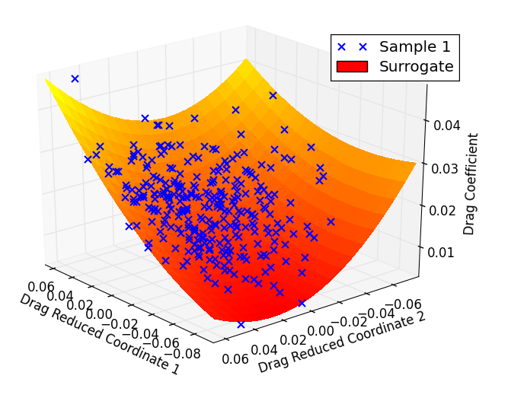
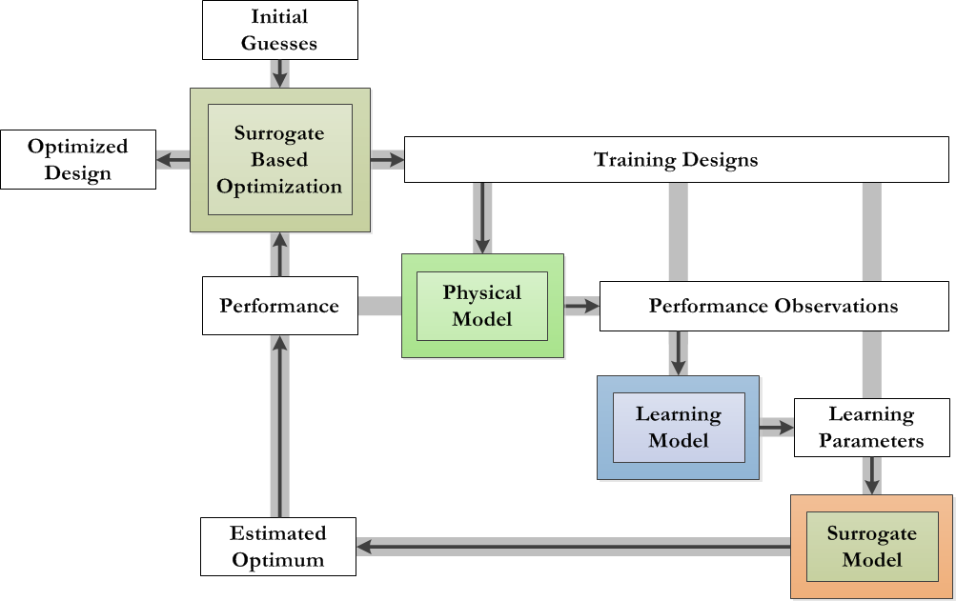
Surrogate Modeling Tools
VyPy
github.com/aerialhedgehog/VyPy
Google search: VyPy
VyPy is a toolbox for optimization and surrogate modeling

Slide 17
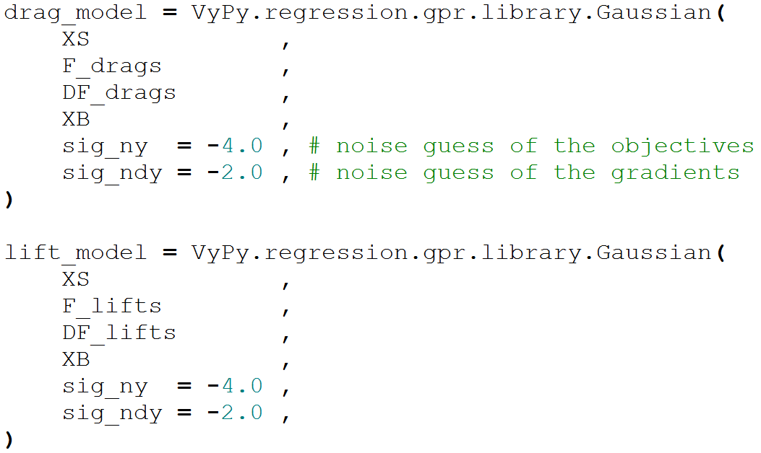
Learning the Surrogate
These GPR surrogate models are trained on the sampled data locations, functions, and gradients.

Slide 18
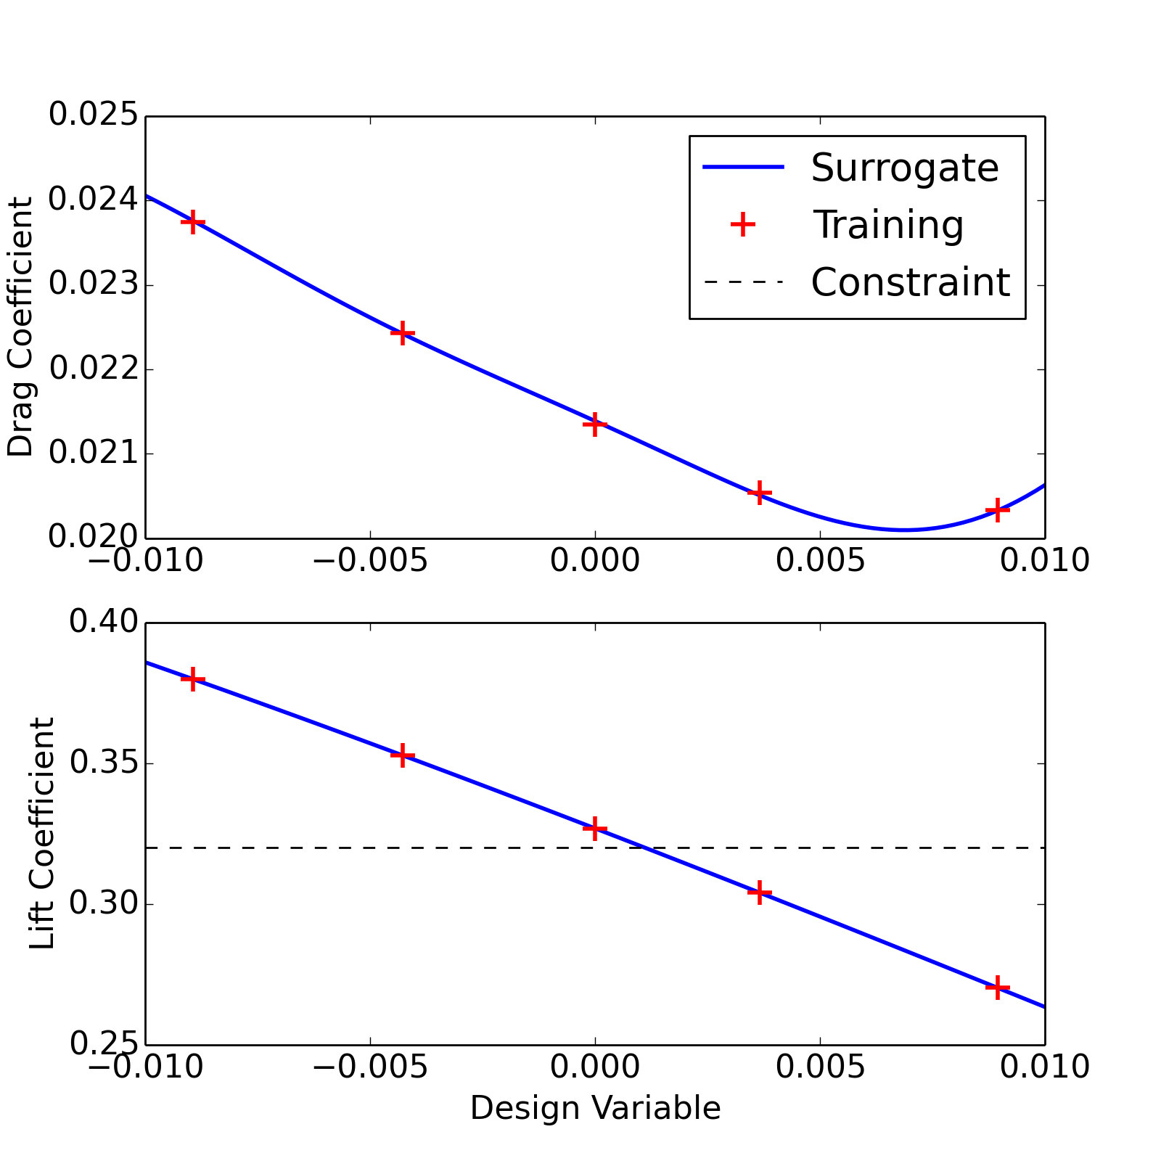
Visualizing the Surrogate Model
In this 1D case we can plot the surrogate model

Slide 19
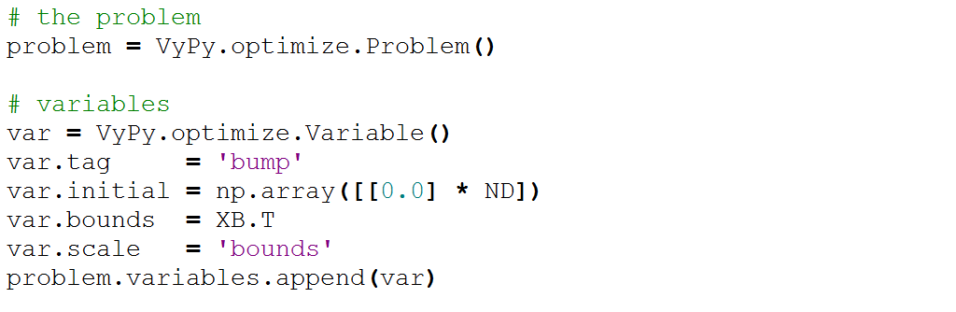
Surrogate Based Optimization
We can now interrogate the surrogate model, for example to estimate an optimum design. Your favorite optimization wrappers can work here. This is an example with VyPy’s wrappers.
Problem Setup

Slide 20
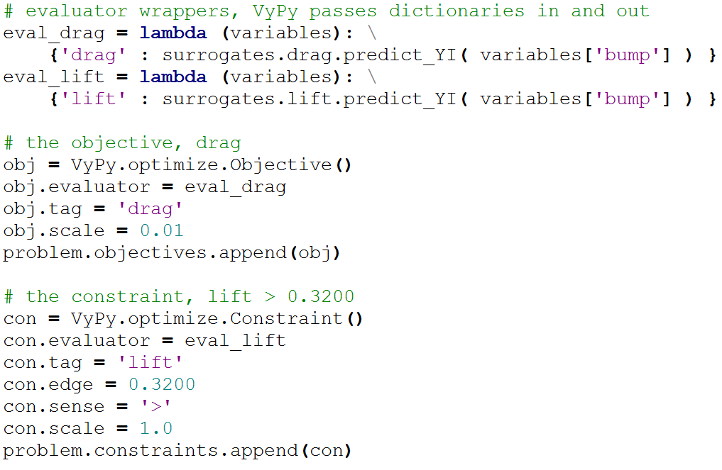
Objective and Constraint

Slide 21
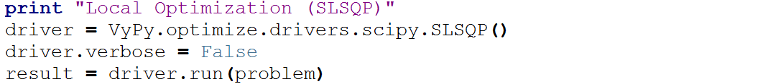
Optimization Wrapper
Results
Surrogate Optimum Prediction
Drag Coefficient 0.0211
Lift Coefficient 0.3200
SU2 Evaluation Check, of the predicted design
Drag Coefficient 0.0211
Lift Coefficient 0.3204

Slide 22
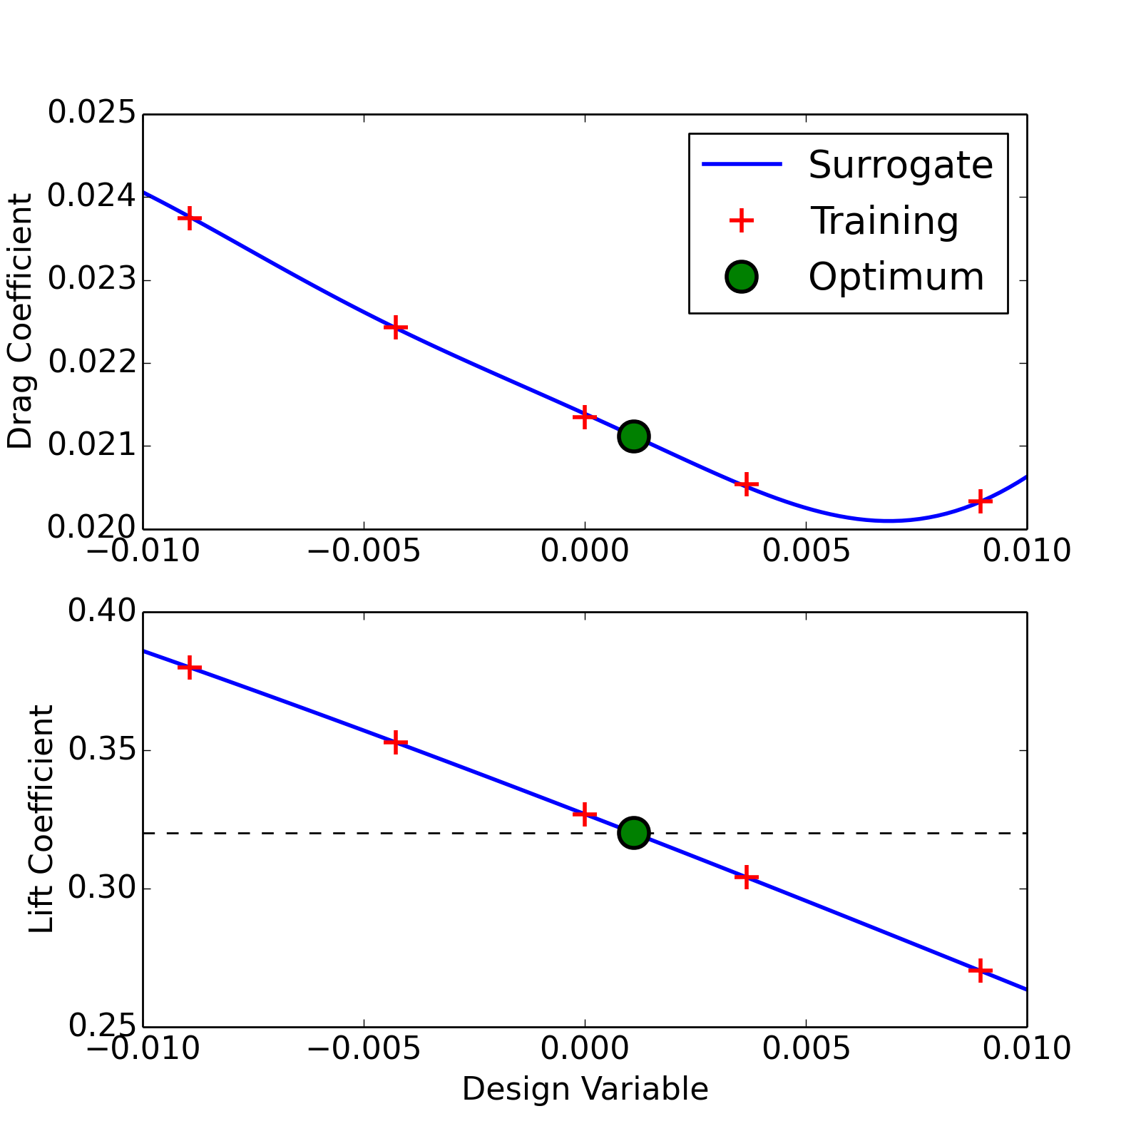
Optimization Results

Slide 23
Topics Covered
Scripting SU2
Saving and loading data
Interacting with the python interpreter
Running a sample of experiments
Surrogate based optimization

